Slide 1


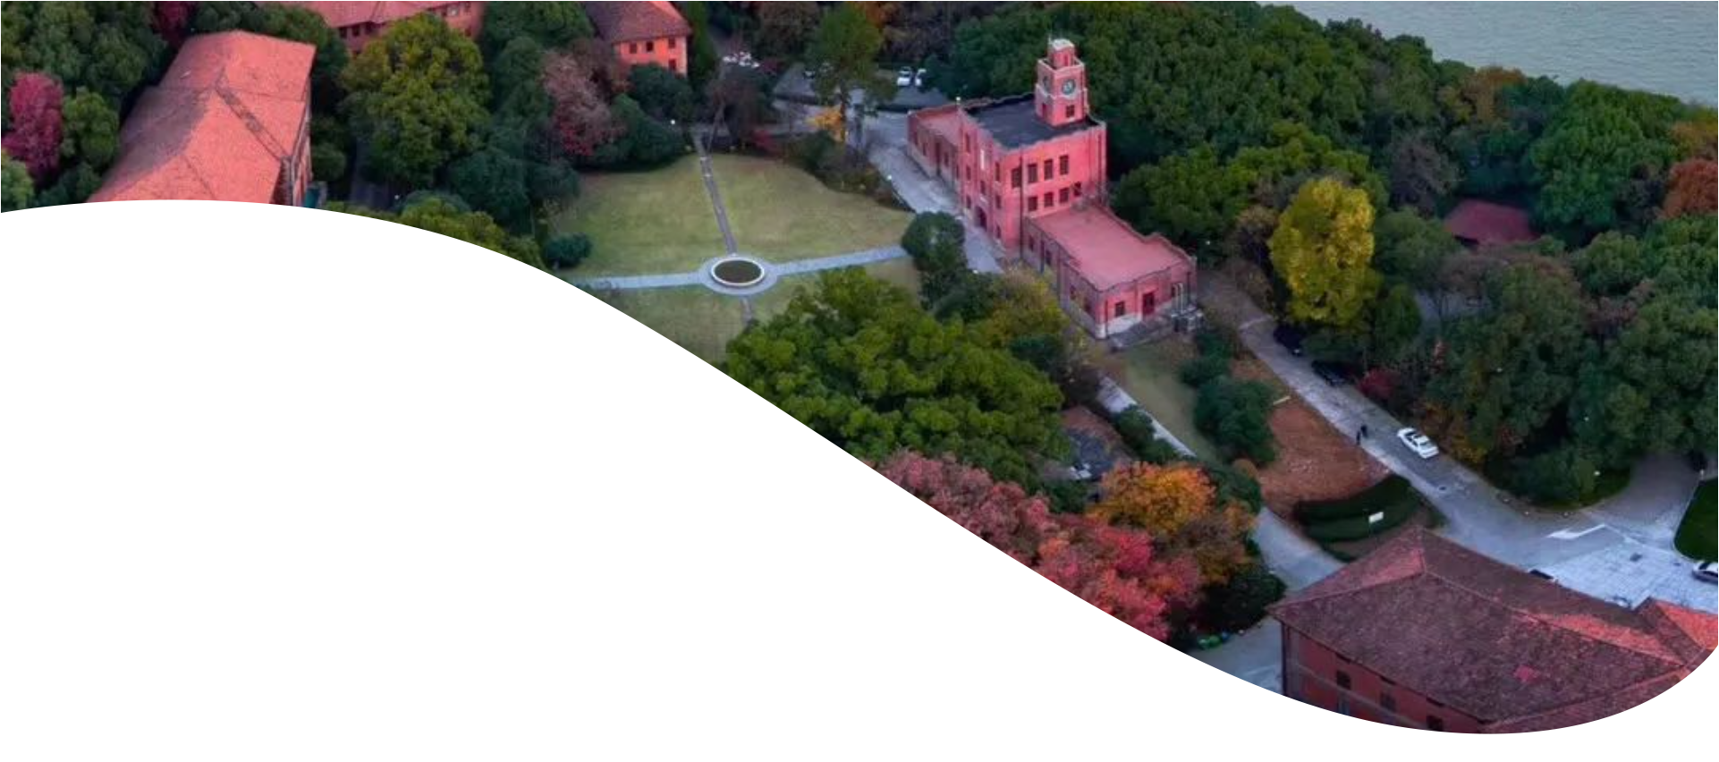

二、隐私的源起与权利理论发展

Slide 2

大纲
一、历史背景
二、隐私权的理论源起
三、隐私权理论的发展
2017/11

Slide 3


一、背景

Slide 4

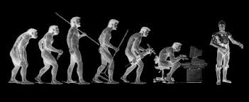
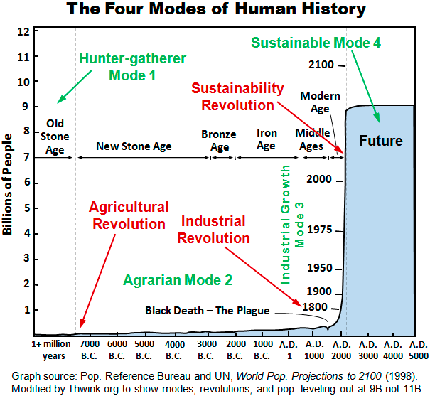


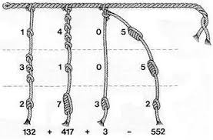

结绳记事是文字发明前，人们所使用的一种记事方法，广泛存在于上古中国和秘鲁印第安人社会，近代的一些尚未发明文字的民族也有此习惯。
约5000年前，古埃及人发明了象形文字

Slide 5
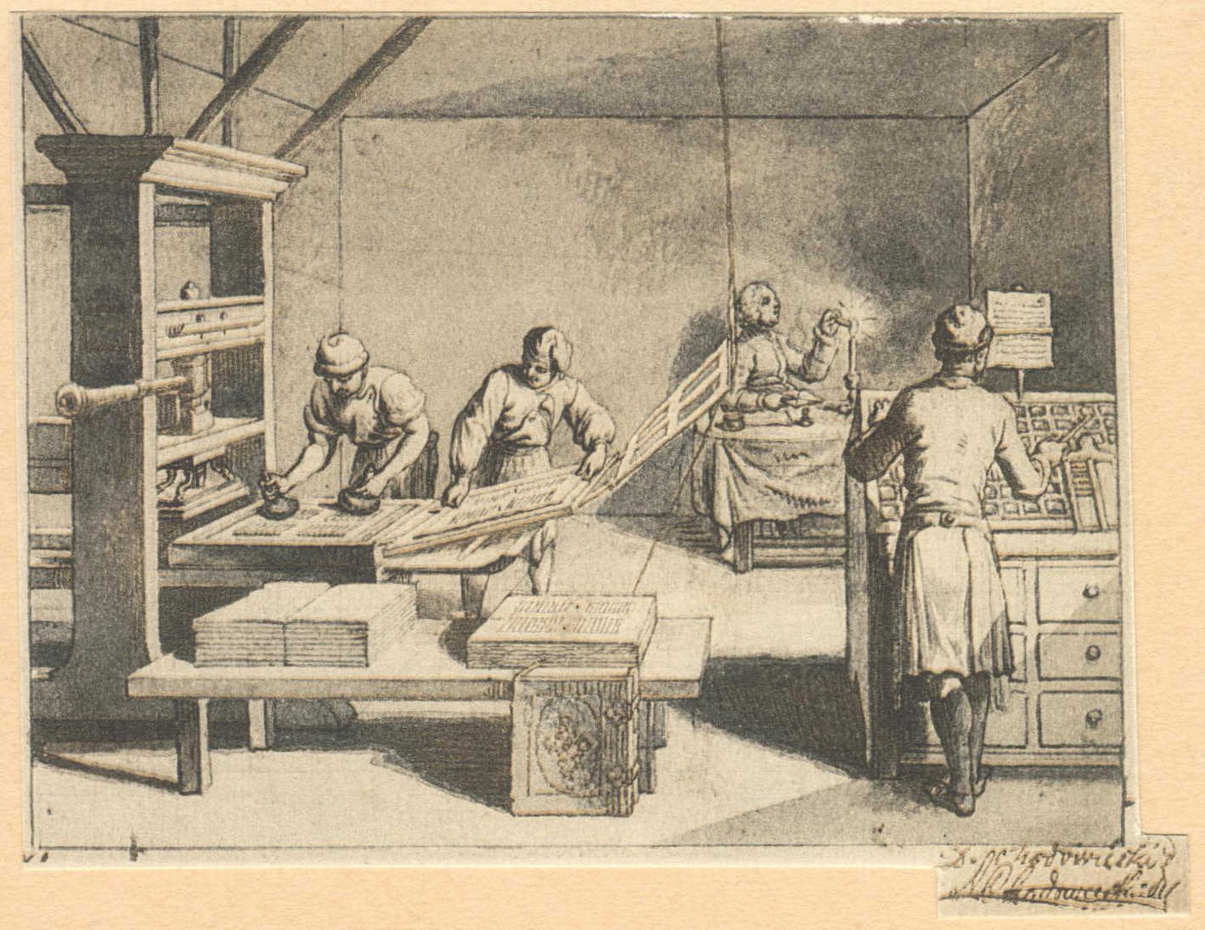
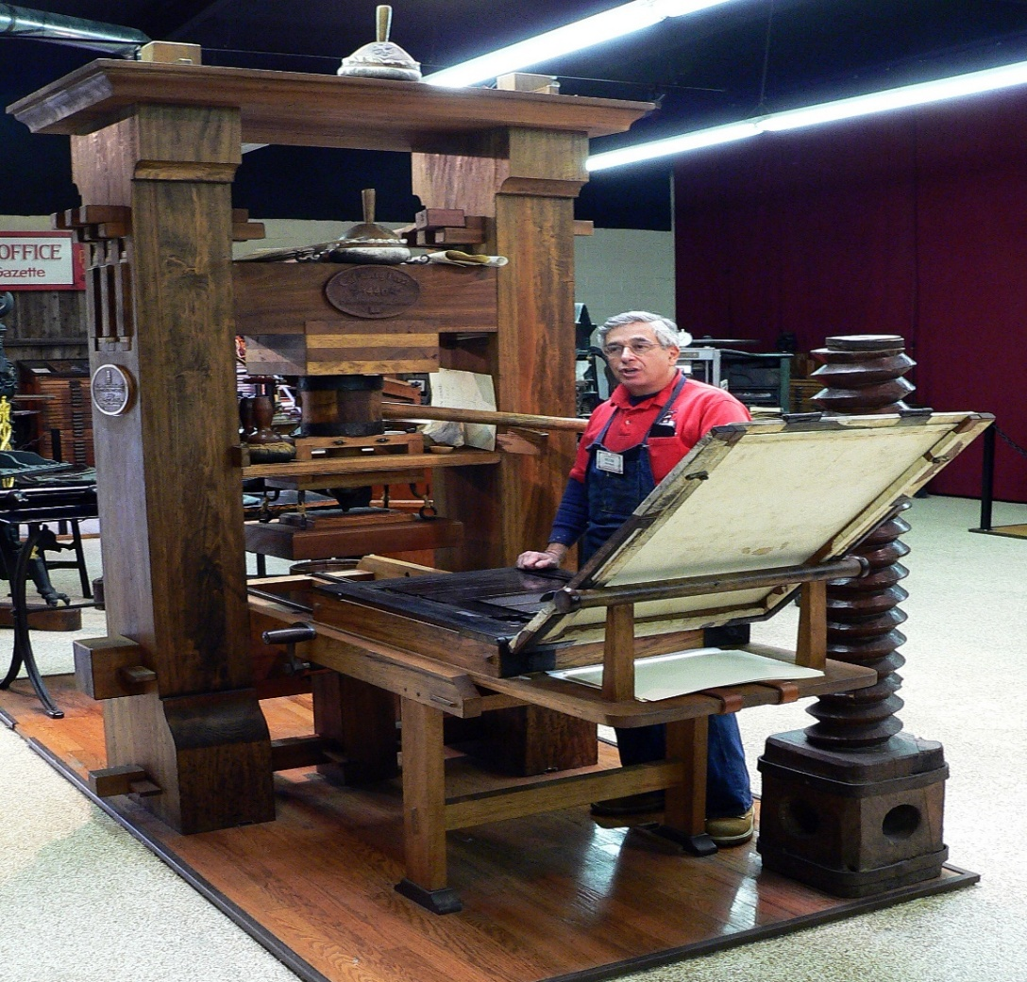
The press became increasingly sensationalistic. Between 1850 and 1890, newspaper circulation increased about 1,000 percent — from 100 papers with 800,000 readers to 900 papers with more than 8 million readers.
Technological developments caused great alarm for privacy. In 1884, the Eastman Kodak Company introduced the “snap camera” a handheld camera that was small and cheap enough for use by the general public.
This development of the law was inevitable. Political, social, and economic changes entail the recognition of new rights, and the common law, in its eternal youth, grows to meet the demands of society.
新闻界变得越来越耸人听闻。在1850年至1890年间，报纸发行量增长了约1000%——从100家报纸拥有80万读者，增长到900家报纸拥有超过800万读者。
科技的发展引起了人们对隐私的极大忧虑。1884年，伊士曼柯达公司推出了“快照相机”，这是一种手持相机，其小巧和廉价足以让普通大众使用。
法律的这一发展是不可避免的。政治、社会和经济的变革必然要求承认新的权利，而普通法在其永恒的活力中，不断发展以满足社会的需求。

Slide 6

Sidis v. F-R Publishing Corp.(1940)
A born genius?
He was able to read the New York Times at the age of 18 months.
By the time he was three, William had learned to operate a typewriter and used it to compose a letter to Macy’s to order toys.
By the time he started elementary school, at the age of six, he could speak and read at least eight languages.
In 1909, Harvard University permitted Sidis to enroll in it; he was 11 years old and the youngest student in the history of Harvard.
His parents did anything to shelter William from the great publicity that followed him from an early age and the tremendous stress that it created in his life.
William James Sidis (1898-1944)
The Sad Life of William James Sidis
Notes:
See materials 2.

Slide 7
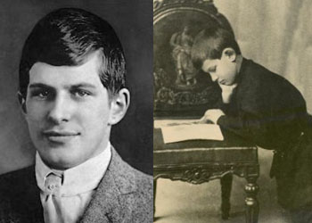
Sidis v. F-R Publishing Corp.(1940)
An Insignificant Adult Life
After graduating from college, Sidis accepted a teaching position at the Rice University in Houston. After a difficult eight months as a professor of mathematics there;
William returned to Boston and enrolled in Harvard Law School in 1916. He left the law school in his last semester there without taking degree.
After that, Sidis engaged in socialist and other radical politics, lived an active social life, addressed a monthly study group, wrote a treatise about the classification of streetcar transfers, and financed his life through a series of modest clerical jobs and sales of his patented “perpetual calendar.”
William James Sidis (1898-1944)
Notes:
See materials 2.

Slide 8
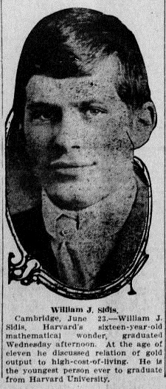
Sidis v. F-R Publishing Corp.(1940)
Lawsuit
Before 1937, Sidis had done an excellent job of avoiding publicity for a decade.
In 1937, a local paper, the Boston Sunday Advertiser, published an article about him. The article recounted the history of Sidis’s life and his current whereabouts: “William James Sidis lives today, at the age of thirty-nine, in a hall bedroom of Boston’s shabby south end” .
The New Yorker article described Sidis’s famous childhood and then recounted his subsequent career as an insignificant clerk.
The article also described Sidis’s dwelling, a small bedroom in a poor part of Boston and his personal activities, interests, and habits.
on July 17, 1944, he died from a cerebral hemorrhage and pneumonia. He was 46 years old and had $652.81 in his bank account.
William James Sidis (1898-1944)
Notes:
See materials 2.
But the article is merciless in its dissection of intimate details of its subject’s personal life, and this in company with elaborate accounts of Sidis’ passion for privacy and the pitiable lengths to which he has gone in order to avoid public scrutiny.
The work possesses great reader interest, for it is both amusing and instructive; but it may be fairly described as a ruthless exposure of a once public character, who has since sought and has now been deprived of the seclusion of private life.
1. After losing his privacy suit against the New Yorker, Sidis sued it for libel for the false information in the story. Among his charges, he claimed that a reader of the article would think that he was a reprehensible character, disloyal to his country, a loathsome and filthy person in personal habits, suffered a mental breakdown, and was a fool, who lived in misery and poverty. The New Yorker settled this case out of court for a small amount of money, which was between $500 and $600.

Slide 9
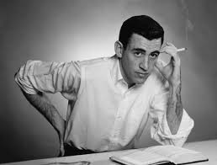
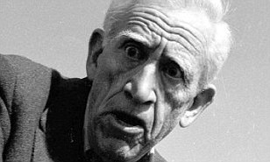
Notes & Questions
Once one is a public figure, one is always a public figure. Can people who were once famous ever retreat into obscurity? Can we assume that anyone who talks to a reporter has abandoned a privacy interest in the information that she shares with the journalist?
In 1998, Joyce Maynard wrote an autobiography, At Home in the World, that describes her romance with J.D. Salinger in the 1970s. In 1999, Maynard auctioned the letters J.D. Salinger wrote to her. She received $156,500 for the letters from the auction. Should Salinger have a right to privacy in the disclosure of the letters? Should privacy law provide Salinger with the right to sue over the writing of Maynard’s book?
How do we protect privacy in a post-Google world?
William James Sidis (1898-1944)
Notes:
The life of William Sidis illustrates a man profoundly disturbed by being thrust by his parents into the limelight as a child and by the media hounding him. He tried to spend his adult life fleeing from being the focus of any public attention. If he had been an involuntary public figure in the past, should this affect whether he should be able to retreat from the public eye in the future? Does it matter that he became a public figure as a child, that is, that he did not voluntarily choose this status as an adult?
Although Salinger tried to escape public exposure as much as possible, he continued to struggle with unwanted attention from both the media and the public.^{[113]} Readers of his work and students from nearby Dartmouth College often came to Cornish in groups, hoping to catch a glimpse of him.
为美国宪法辩护.

Slide 10

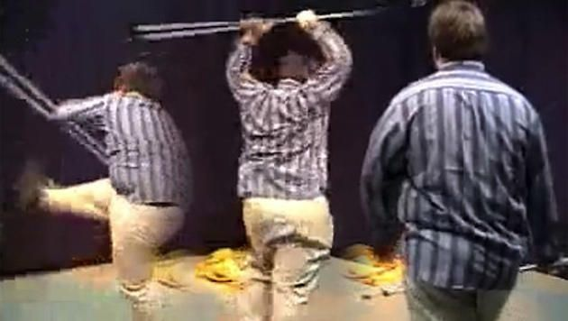
Sidis v. F-R Publishing Corp.(1940)
Notes & Questions
4. An overweight, awkward 15-year-old kid videotaped himself pretending to be a character from a Star Wars movie.
Somebody found the video, digitized it, and posted it on the Internet. The video created a buzz, and it was downloaded millions of times around the world. Versions of the video with music and special effects were soon posted. People made fun of the kid in various discussions throughout the Internet.
“Star Wars kid” disliked the attention. Does it matter that the parents of the “Star Wars kid” alleged that the clip of their son was placed online without his permission? In contrast, Brolsma posted the video of his dance himself. Is there something that the law can do to protect people like the Star Wars kid or the Numa Numa dancer? If so, what?
The Star War Kid
Remember Remember Star Wars Kid
Notes:
1. School bully problem. Sending naked photos.

Slide 11

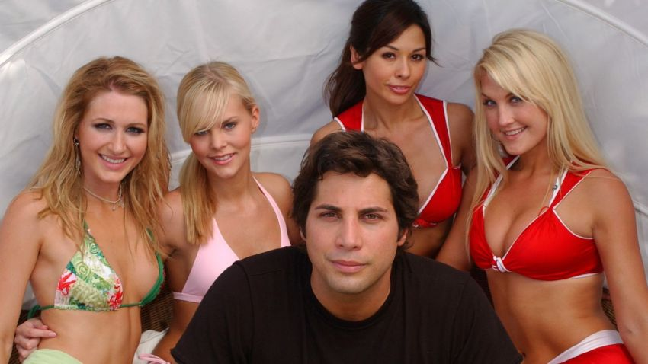
Sidis v. F-R Publishing Corp.(1940)
Notes & Questions
5. Some women, often intoxicated, reveal their nudity in public and give their permission to use the video footage on the company’s videotapes, which are called “Girls Gone Wild.”
Later on, when sober, some of the women regret their decision to be in the video. Have they waived all privacy rights to their nude images on the video if they sign a consent form? Or should they be entitled to have some time to reconsider? Do they have a valid privacy claim even when they exposed themselves in public?
William James Sidis (1898-1944)

Slide 12
二、隐私权的理论源起

Slide 13
Privacy Protection：Origins and Types
塞缪尔·D·沃伦（Samuel D. Warren）与路易斯·D·布兰迪斯（Louis D. Brandeis），“隐私权”，《哈佛法律评论》第4卷（1890年），第193-220页。
一项新权利的必要性。 该文章主张创立一项新的权利——隐私权。
哲学根源：美国与德国的“不可侵犯的人格”。 作者将隐私描述为并非源于“私有财产原则，而是源于不可侵犯的人格原则”。
“独处的权利”。 沃伦和布兰迪斯将隐私权称为“独处的权利”（the right to be let alone），并认为侵犯隐私权本身即可构成获得赔偿的基础。
现有的相关法律。 当时已有的法律，如反侮辱法、诽谤法、美国财产法、个人肖像权法以及商业秘密法，都未能为隐私提供充分的保护。
Samuel D. Warren and Louis D. Brandeis, “The Right to Privacy”, 4(1890) The Harvard Law Review, pp. 193-220.
The Need for a New Right. The article argued for the creation of a new right — the right to privacy.
Philosophical roots: Inviolate Personality in the United States and Germany. The authors describe privacy as not “the principle of private property but that of inviolate personality.”
“The Right to Be Let Alone.” Warren and Brandeis refer to privacy as “the right to be let alone” , and the violation of the right to privacy itself may be considered a basis for compensation.
Existing Relevant Laws. Existing laws like anti-insult and defamation laws, US property laws, personal image rights, and trade secret laws do not provide adequate protection for privacy.
Louis D. Brandeis （1856—1941）

Slide 14
Privacy Protection：Origins and Types
塞缪尔·D·沃伦（Samuel D. Warren）与路易斯·D·布兰迪斯（Louis D. Brandeis），“隐私权”，《哈佛法律评论》第4卷（1890年），第193-220页。
隐私权的范围。 布兰迪斯和沃伦谨慎地指出，隐私权并非一项绝对权利。他们为隐私权设定了几项限制。
救济措施。 （可采取）侵权诉讼和禁令。这些救济措施与诽谤法和版权法中的相似。此外，还可采取刑事救济。
沃伦和布兰迪斯的观点。 他们认为，不仅需要通过立法在刑法中为隐私提供额外保护，整个社会也应承担起保护隐私的责任。
Samuel D. Warren and Louis D. Brandeis, “The Right to Privacy”, 4(1890) The Harvard Law Review, pp. 193-220.
The Scope of the Right to Privacy. Brandeis and Warren were careful not to describe privacy as an absolute right. They set out several limitations on the right to privacy.
Remedies. An action in tort and injunction. These remedies are similar to those in defamation and copyright. A criminal remedy.
Warren and Brandeis argue that not only legislation is needed to provide additional protection for privacy in criminal law, but also society should also bear the responsibility for protection.
Louis D. Brandeis （1856—1941）

Slide 15
三、隐私权理论的深化

Slide 16
William L. Prosser, Privacy, 48 (1960) California Law Review,
隐私法包含四种不同类型的侵权行为，分别侵害了原告的四种不同利益：
侵扰原告的清静、独处或其私人事务。 (Intrusion upon the plaintiff’s seclusion or solitude, or into his private affairs.)
公开披露关于原告的、令人难堪的私密事实。 (Public disclosure of embarrassing private facts about the plaintiff.)
公开宣传，使原告在公众眼中被置于一种错误的形象之下。 (Publicity which places the plaintiff in a false light in the public eye.)
为被告的利益，盗用原告的姓名或肖像。 (Appropriation, for the defendant’s advantage, of the plaintiff’s name or likeness.)
Understanding the connotation of the right to privacy depends on specific torts, and the actual torts are actually the synthesis of four kinds of torts.
The law of privacy comprises four distinct kinds of invasion of four different interests of the plaintiff：
Intrusion upon the plaintiff’s seclusion or solitude, or into his private affairs.
Public disclosure of embarrassing private facts about the plaintiff.
Publicity which places the plaintiff in a false light in the public eye.
Appropriation, for the defendant’s advantage, of the plaintiff’s name or likeness.

Slide 17
William L. Prosser, Privacy, 48 (1960) California Law Review,
Case
1. Intrusion upon Seclusion
Case: Gill v. Curtis Pub. Co. (California, 1952)
Fact: The plaintiff, Gill, was photographed by a journalist while embracing his wife in the Farmers' Market in Los Angeles. The photo was published in a magazine with an article implying that their behavior was inappropriate.
Question: Does the publication of a photograph taken in a public place without consent constitute an invasion of privacy?
Ruling: The court held that although the photo was taken in a public place, the use of the photograph with a misleading caption that placed the plaintiff in a false light constituted an invasion of privacy.
2. Public Disclosure of Private Facts
Case: Melvin v. Reid (California, 1931)
Fact: The plaintiff, Melvin (formerly known as Gabrielle Darley), had a past as a prostitute but had reformed and married. The defendant, Reid, produced and exhibited a motion picture titled "The Red Kimono," which revealed Melvin's past, causing her great distress.
Question: Does the public disclosure of true but private facts about an individual's past constitute an invasion of privacy?
Ruling: The court ruled that the disclosure of Melvin's past, which was a private matter, caused her mental suffering and constituted an invasion of privacy.

Slide 18
William L. Prosser, Privacy, 48 (1960) California Law Review,
Case
1. 侵扰宁静 (Intrusion upon Seclusion)
案例： 吉尔诉柯蒂斯出版公司案 (Gill v. Curtis Pub. Co.) (加利福尼亚州, 1952年)
事实： 原告吉尔（Gill）在洛杉矶农夫市场拥抱其妻子时，被一名记者拍照。该照片被刊登在一本杂志上，并配有一篇文章，暗示他们的行为不当。
问题： 在公共场所未经同意拍摄并发表照片，是否构成侵犯隐私权？
裁决： 法院认为，尽管照片是在公共场所拍摄的，但该照片与误导性文字一同使用，将原告置于一种错误的形象之下（false light），这构成了对隐私权的侵犯。
2. 公开披露私密事实 (Public Disclosure of Private Facts)
案例： 梅尔文诉里德案 (Melvin v. Reid) (加利福E尼亚州, 1931年)
事实： 原告梅尔文（Melvin），其曾用名为加布里埃尔·达利（Gabrielle Darley），过去曾是一名妓女，但后来已经改过自新并已结婚。被告里德（Reid）制作并上映了一部名为《红色和服》（"The Red Kimono"）的电影，揭露了梅尔文的过去，给她造成了巨大的痛苦。
问题： 公开披露关于个人过去的、虽真实但属私密的事实，是否构成侵犯隐私权？
裁决： 法院裁定，披露梅尔文的过去这一私人事务，给她造成了精神痛苦，构成了对隐私权的侵犯。

Slide 19
William L. Prosser, Privacy, 48 (1960) California Law Review,
Case
3. False Light in the Public Eye
Case: Rozhon v. Triangle Publications (7th Circuit, 1956)
Fact: The plaintiff, Rozhon, was an ordinary citizen whose photograph was used in an article about "man-hungry women," implying that he was associated with the content of the article.
Question: Does placing a person in a false light by associating their photograph with misleading content constitute an invasion of privacy?
Ruling: The court held that using Rozhon's photograph in connection with false and misleading content placed him in a false light before the public, constituting an invasion of privacy.
4. Appropriation of Name or Likeness
Case: Flores v. Mosler Safe Co. (New York, 1959)
Fact: The plaintiff, Flores, was an ordinary citizen whose name and photograph were used by Mosler Safe Co. in an advertisement, falsely claiming that he endorsed their products.
Question: Does the unauthorized use of a person's name and likeness for commercial purposes constitute an invasion of privacy?
Ruling: The court ruled that the unauthorized commercial use of Flores' name and likeness violated his right to privacy and constituted an invasion of privacy.

Slide 20
William L. Prosser, Privacy, 48 (1960) California Law Review,
Case
3. 公众眼中的错误形象 (False Light in the Public Eye)
案例： 罗洪诉三角出版公司案 (Rozhon v. Triangle Publications) (第七巡回法院, 1956年)
事实： 原告罗洪（Rozhon）是一名普通公民，他的照片被用于一篇关于“渴望男人的女人”的文章中，暗示他与文章内容有关。
问题： 将个人照片与误导性内容相关联，从而使其陷入错误形象，是否构成侵犯隐私权？
裁决： 法院认为，将罗洪的照片与虚假和误导性的内容联系在一起使用，使他在公众面前被置于一种错误的形象之下，这构成了对隐私权的侵犯
4. 盗用姓名或肖像 (Appropriation of Name or Likeness)
案例： 弗洛雷斯诉莫斯勒保险箱公司案 (Flores v. Mosler Safe Co.) (纽约州, 1959年)
事实： 原告弗洛雷斯（Flores）是一名普通公民，他的姓名和照片被莫斯勒保险箱公司（Mosler Safe Co.）用于一则广告中，并谎称他为该公司的产品背书。
问题： 未经授权为商业目的使用他人的姓名和肖像，是否构成侵犯隐私权？
裁决： 法院裁定，未经授权商业性使用弗洛雷斯的姓名和肖像，侵犯了他的隐私权，并构成了对隐私权的侵害。

Slide 21
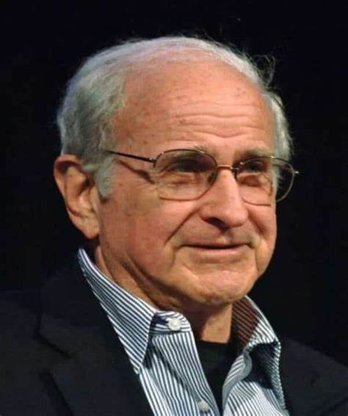
Alan Westin, Privacy and Freedom (1967)
Privacy is the claim of individuals, groups, or institutions to determine for themselves when, how, and to what extent information about them is communicated to others.
Privacy is the voluntary and temporary withdrawal of a person from the general society through physical or psychological means, either in a state of solitude or small-group intimacy or, when among larger groups, in a condition of anonymity or reserve.
The four states of privacy
Solitude.
The individual is separated from the group and freed from the observation of other persons. But, despite all these physical or psychological intrusions, solitude is the most complete state of privacy that individuals can achieve.
1929年-2013年
哥伦比亚大学教授
Intimacy
The individual is acting as part of a small unit that claims and is allowed to exercise corporate seclusion so that it may achieve a close, relaxed, and frank relationship between two or more individuals.

Slide 22
Alan Westin, Privacy and Freedom (1967)
隐私是个人、团体或机构为自己决定，关于他们的信息在何时、以何种方式以及在何种程度上与他人沟通的权利主张。
隐私是个人通过物理或心理手段，自愿地、暂时地脱离大众社会，或进入独处状态，或处于小团体亲密关系之中，或者在较大群体中，处于匿名或矜持的状态。
隐私的四种状态
独处 (Solitude)
个人与群体分离，不受他人观察。但是，尽管存在所有这些物理上或心理上的侵扰，独处是个人所能达到的最完全的隐私状态。
亲密 (Intimacy)
个人作为一个小单位的成员行事，该单位主张并被允许实行集体性的隐退（corporate seclusion），以便在两个或多个个体之间建立起一种紧密、放松且坦诚的关系。
1929年-2013年
哥伦比亚大学教授

Slide 23
Alan Westin, Privacy and Freedom (1967)
Anonymity.
Occurs when the individual is in public places or performing public acts but still seeks, and finds, freedom from identification and surveillance. Unless he is a well-known celebrity, he does not expect to be personally identified and held to the full rules of behavior and role that would operate if he were known to those observing him.
Still another kind of anonymity is the publication of ideas anonymously.
Confidentiality
The creation of a psychological barrier against unwanted intrusion; this occurs when the individual’s need to limit communication about himself is protected by the willing discretion of those surrounding him.
Most of our lives are spent not in solitude or anonymity but in situations of intimacy and in group settings where we are known to others. Even in the most intimate relations, communication of self to others is always incomplete and is based on the need to hold back some parts of one’s self as either too personal and sacred or too shameful and profane to express.

Slide 24
Alan Westin, Privacy and Freedom (1967)
匿名 (Anonymity)
当个体身处公共场所或从事公共行为，但仍然寻求并获得了免于被识别和监视的自由时，匿名就发生了。除非他是知名人士，否则他不会预料到自己会被人认出，并被要求遵守那些在他被观察者认识的情况下才会适用的全部行为和角色规范。
另一种匿名形式是匿名发表观点。
保密 (Confidentiality)
这是指建立一道心理屏障以抵御不必要的侵扰；当个体限制谈论自身信息的需求，得到其周围人自愿的审慎处理和保护时，保密就实现了。
我们生命中的大部分时间并非在独处或匿名中度过，而是在亲密关系和群体环境中，我们被他人所熟知。即使在最亲密的关系中，个人向他人的自我沟通也总是不完整的，这是基于一种需求——即将自己的某些部分保留起来，因为它们要么过于私人和神圣，要么过于可耻和不敬，而不便表达。

Slide 25
Alan Westin, Privacy and Freedom (1967)
Four functions of privacy
Personal Autonomy
. . . . Each person is aware of the gap between what he wants to be and what he actually is, between what the world sees of him and what he knows to be his much more complex reality. Every individual lives behind a mask in this manner;
The autonomy that privacy protects is also vital to the development of individuality and consciousness of individual choice in life. . . . This development of individuality is particularly important in democratic societies, since qualities of independent thought, diversity of views, and non-conformity are considered desirable traits for individuals. The individual’s sense that it is he who decides when to “go public” is a crucial aspect of his feeling of autonomy.
隐私的四种功能
个人自主 (Personal Autonomy)
… 每个人都意识到，在他想成为的样子与他实际的样子之间，在世界所看到的他与他自知的远为复杂的现实之间，存在着一道鸿沟。从这个意义上说，每个人都生活在一副面具之后。
隐私所保护的自主性，对于个人特质的发展和生命中个人选择意识的形成也至关重要… 这种个人特质的发展在民主社会中尤为重要，因为独立思考、观点多样和不墨守成规的品质被认为是可取的个人特质。个人感觉由自己来决定何时“走向公众”，是他自主感的一个关键方面。

Slide 26
Alan Westin, Privacy and Freedom (1967)
Four functions of privacy
Emotional Release.
Life in society generates such tensions for the individual that both physical and psychological health demand periods of privacy for various types of emotional release. Such relaxation is required from the pressure of playing social roles. Each person constantly plays a series of varied and multiple roles, depending on his audience and behavioral situation. No individual can play indefinitely, without relief, the variety of roles that life demands. There have to be moments “off stage” when the individual can be “himself”.
Minor non-compliance with social norms. The firm expectation of having privacy for permissible deviations is a distinguishing characteristic of life in a free society.
Another aspect of release is the “safety-valve” function afforded by privacy. Most persons need to give vent to their anger at “the system,” “city hall,” “the boss,” and various others who exercise authority over them, and to do this in the intimacy of family or friendship circles, or in private papers, without fear of being held responsible for such comments.
情绪释放 (Emotional Release)
社会生活给个人带来了诸多紧张情绪，以至于身心健康都需要有隐私时段，以进行各种类型的情绪释放。这种放松是为了从扮演社会角色的压力中解脱出来。每个人都根据他面对的“观众”和行为情境，持续扮演着一系列多样且多重的角色。没有任何人能够无休止地、不加喘息地扮演生活所要求的各种角色。必须有一些“后台”时刻，让个人可以做“他自己”。
对社会规范的轻微违背。 在一个自由社会里，人们对于拥有隐私以进行被允许的偏离行为抱有坚定的期望，这是其生活的一个显著特征。
情绪释放的另一个方面是隐私所提供的“安全阀”功能。 大多数人需要发泄他们对“体制”、“市政厅”、“老板”以及其他各种对他们行使权力者的愤怒。他们需要在家庭或朋友圈的私密环境中，或在私人文件中这样做，而不必担心要为这些言论负责。

Slide 27
Alan Westin, Privacy and Freedom (1967)
Four functions of privacy
Self-evaluation
Privacy as a Space for Self-Reflection. Privacy provides individuals with the solitude necessary for self-evaluation, allowing them to critically assess their own behaviors, thoughts, and desires without the influence of external judgment. Westin notes: "The individual needs a place of refuge from the pressures of social life, a place where he can be 'himself' and drop the mask of social roles.“
Privacy as a Foundation for Democratic Societies. Privacy is not just an individualistic pursuit but a cornerstone of democratic societies. It allows individuals to form and revise their opinions independently before sharing them publicly. Westin emphasizes: "In a free society, the ability to engage in private self-reflection and self-criticism is vital for fostering independent thought and a diversity of viewpoints."
自我评估 (Self-evaluation)
隐私作为自我反思的空间。 隐私为个人提供了自我评估所必需的独处（solitude），使他们能够在不受外界评判影响的情况下，批判性地审视自己的行为、思想和欲望。韦斯汀（Westin）指出： “个人需要一个躲避社会生活压力的避难所，一个他可以‘做自己’并摘下社会角色面具的地方。”
隐私作为民主社会的基石。 隐私不仅仅是一种个人主义的追求，更是民主社会的基石。它允许个人在公开发表意见之前，独立地形成和修正自己的看法。韦斯汀强调： “在一个自由的社会里，能够进行私下的自我反思和自我批评，对于培养独立思想和观点的多样性至关重要。”

Slide 28
Alan Westin, Privacy and Freedom (1967)
Four functions of privacy
Limited and Protected Communication
The greatest threat to civilized social life would be a situation in which each individual was utterly candid in his communications with others, saying exactly what he knew or felt at all times.
Privacy for limited and protected communication has two general aspects. First, it provides the individual with the opportunities he needs for sharing confidences and intimacies with those he trusts.
Second, the individual often wants to secure counsel from persons with whom he does not have to live daily after disclosing his confidences. He seeks professionally objective advice from persons whose status in society promises that they will not later use his distress to take advantage of him.
有限和受保护的沟通 (Limited and Protected Communication)
对文明社会生活最大的威胁是这样一种情境：每个在与他人交流时都完全坦率，在任何时候都说出他所知道或感受到的一切。
用于有限和受保护沟通的隐私有两个基本方面。首先，它为个人提供了与他们信任的人分享秘密和亲密关系所需的机会。
其次，个人常常希望从那些在吐露心声后不必与之朝夕相处的人那里获得咨询。他向那些其社会地位能保证他们日后不会利用他的困境来占他便宜的专业人士寻求客观的建议。

Slide 29
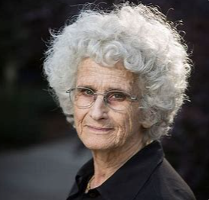
Ruth Gavison, “Privacy and the Limits of Law”, The Yale Law Journal 89(3) 1980.
Core Idea. Protecting privacy should be the explicit commitment of the law.
Concept and Connotation of Privacy.
(a) Information Known About an Individual;
(b) Attention Paid to an Individual;
(c) Physical Access to an Individual.
核心理念： 保护隐私应当是法律的明确承诺。
隐私的概念与内涵：
(a) 关于个人的已知信息； (b) 投向个人的关注； (c) 对个人的物理接近。
Ruth Gavison

Slide 30
Ruth Gavison, “Privacy and the Limits of Law”, The Yale Law Journal 89(3) 1980.
Pluralistic Social Function of Privacy.
(a) privacy is what enables development of individuality by allowing individuals to distinguish between their own thoughts and feelings and those of others;
(b) privacy insulates that individual from distraction and from the inhibitive effects that arise from close physical proximity with another individual;
(c) Promoting Liberty of Action - Freedom from censure and ridicule, Promoting autonomy, and Promoting human relations;
(d) privacy indicate the existence of and contribute to a more pluralistic, tolerant society.
The author emphasized that everyone is in a certain social connection, and neither a complete privacy state nor a complete loss of privacy is desirable.

Slide 31
Ruth Gavison, “Privacy and the Limits of Law”, The Yale Law Journal 89(3) 1980.
隐私的多元社会功能 (Pluralistic Social Function of Privacy)
(a) 隐私通过允许个人区分自己的思想情感与他人的思想情感，从而促进了个性的发展；
(b) 隐私使个人免受干扰，也免受与他人身体距离过近所产生的抑制效应；
(c) 促进自由行动——免于责难和嘲笑的自由、促进自主性以及促进人际关系；
(d) 隐私的存在表明并有助于一个更加多元和宽容的社会。
作者强调，每个人都处于特定的社会联系之中，完全的隐私状态或完全丧失隐私都是不可取的。

Slide 32

Helen Nissenbaum, “Privacy as Contextual Integrity”, Washington Law Review 79(2004).
The current privacy protection theory, which is composed of three basic principles, plays a dominant role.
Three basic principles:
(1) protect citizens' information from misuse by government agencies;
(2) restrict access to citizens' personal privacy and sensitive information;
(3) limit the intrusion on citizens' private space.
Reasons why three basic principles are difficult to protect privacy in public surveillance:
public surveillance does not involve government agents seeking to expand access to citizens; or collection or disclosure of sensitive, confidential, or personal information; or intrusion into spaces or spheres normally judged to be private or personal.
public records online are inherently public information, not private or sensitive information.

Slide 33
Helen Nissenbaum, “Privacy as Contextual Integrity”, Washington Law Review 79(2004).
当前，由三项基本原则构成的隐私保护理论占据主导地位。
三项基本原则：
(1) 保护公民信息免遭政府机构滥用；
(2) 限制对公民个人隐私和敏感信息的访问；
(3) 限制对公民私人空间的侵扰。
为何这三项基本原则难以在公共监控中保护隐私：
公共监控并不涉及政府人员寻求扩大对公民信息的访问权限；也不涉及收集或披露敏感、机密或个人信息；更不涉及侵入通常被认为是私人的或个人的空间或领域。
网络上的公共记录本质上是公开信息，而非私人或敏感信息。

Slide 34
Helen Nissenbaum, “Privacy as Contextual Integrity”, Washington Law Review 79(2004).
Public Surveillance. The current basic theory of privacy protection can not protect the privacy of citizens in public surveillance, and a new concept, contextual integrity, is proposed to solve the above problems.
The core concept of contextual integrity is that all events occur in a specific scene and are affected by certain political, cultural, historical, custom and other factors, and the protection of privacy must also be based on a specific scene.
Norms:
Appropriateness: norms of appropriateness dictate what information about persons is appropriate, or fitting, to reveal in a particular context. Generally, these norms circumscribe the type or nature of information about various individuals that, within a given context, is allowable, expected, or even demanded to be revealed.
Distribution of information: whether its distribution, or flow, respects contextual norms of information flow.
Contextual integrity is maintained when both types of norms are upheld, and it is violated when either of the norms is violated.
Public monitoring is largely a violation of contextual integrity.

Slide 35
Helen Nissenbaum, “Privacy as Contextual Integrity”, Washington Law Review 79(2004).
公共监控 (Public Surveillance)。 当前的隐私保护基本理论无法在公共监控中保护公民的隐私，（作者）提出了一个新概念——“情境完整性”（contextual integrity），以解决上述问题。
“情境完整性”的核心概念是：所有事件都发生在特定的场景中，并受到某些政治、文化、历史、习俗及其他因素的影响，因此对隐私的保护也必须基于特定的场景。
规范 (Norms)：
适当性 (Appropriateness)： 适当性规范决定了在特定情境下，披露关于个人的何种信息是适当的或合适的。通常，这些规范界定了在给定情境中，允许、期望甚至要求披露的、关于不同个人的信息的类型或性质。
信息分发 (Distribution of information)： 指信息的分配或流动是否尊重了情境性的信息流动规范。
当这两种规范都得到维护时，“情境完整性”就得以保持；而当其中任何一种规范被违反时，它就遭到了侵犯。
公共监控在很大程度上就是对“情境完整性”的侵犯。

Slide 36
Helen Nissenbaum, “Privacy as Contextual Integrity”, Washington Law Review 79(2004).
Applying contextual integrity Theory
Cases: Public records Online
Consumer Profiling and Data Mining
Radio frequency identification
Competent merchants, paying attention to what customers wanted, would provide stock accordingly. Although the online bookseller Amazon.com maintains and analyzes customer records electronically, using this information as a basis for marketing to those same customers, seems not to be a significant departure from entrenched norms of appropriateness and flow.
The grocer who bombards shoppers with questions about other lifestyle choices-e.g., where they vacationed, what movies they recently viewed, what books they read, where their children attend school or college does breach norms of appropriateness. The grocer who provides information about grocery purchases to vendors of magazine subscriptions or information brokers is responsible not only for breaches of norms of appropriateness but also norms of flow.
研讨：裁判文书公开与行政处罚决定公开

Slide 37
Helen Nissenbaum, “Privacy as Contextual Integrity”, Washington Law Review 79(2004).
Applying contextual integrity Theory
案例：
网络公共记录 (Public records Online)
消费者画像与数据挖掘 (Consumer Profiling and Data Mining)
射频识别 (Radio frequency identification)
有能力的商家会关注顾客的需求，并相应地提供货品。尽管在线书商亚马逊（Amazon.com）以电子方式维护和分析顾客记录，并将这些信息用作向这些顾客进行营销的基础，但这似乎并未显著偏离根深蒂固的适当性规范和（信息）流动规范。
如果一个杂货店老板用关于其他生活方式选择的问题来“轰炸”购物者——例如，他们去哪里度假、最近看了什么电影、读了什么书、孩子在哪所学校或大学上学——那么他就违反了适当性规范。而如果这个杂-货店老板将顾客的购物信息提供给杂志订阅销售商或信息掮客，那么他不仅要为违反适当性规范负责，也要为违反（信息）流动规范负责。

Slide 38

James Q. Whitman, “The Two Western Cultures of Privacy: Dignity versus Liberty”, 113(2004) The Yale Law Journal.
Evolving privacy does not yet have a clear definition, because typical privacy theories focus on behaviors that violate privacy and lead people to understand privacy by judging these behaviors intuitively.
Transatlantic Clash: The cultural and institutional conflicts in privacy protection between the United States and continental Europe are significant, which affects transatlantic trade.
Eg.
America is a place where strangers suddenly share information with you about their "private activities" in a way that is "difficult to imagine" for northern Europeans or Asians.
Americans have a particularly embarrassing habit, continental Europeans believe, of talking about salaries. It is "normal in America," an Internet site informs German tourists, for your host at dinner to ask "not just how much you earn, but even what your net worth is -- topics ordinarily quite off-limits under the rules of European etiquette.
James Q. Whitman

Slide 39
James Q. Whitman, “The Two Western Cultures of Privacy: Dignity versus Liberty”, 113(2004) The Yale Law Journal.
演变中的隐私（Evolving privacy）尚未有一个明确的定义，因为典型的隐私理论侧重于侵犯隐私的行为，并引导人们通过直观地判断这些行为来理解隐私。
跨大西洋的冲突 (Transatlantic Clash)： 美国与欧洲大陆在隐私保护方面的文化和制度冲突非常显著，这影响了跨大西洋的贸易。
例如：
在美国，陌生人会突然与你分享关于他们“私人活动”的信息，其方式对于北欧人或亚洲人来说是“难以想象的”。
欧洲大陆的人认为，美国人有一个特别令人尴尬的习惯，就是谈论薪水。一个网站这样告知德国游客：在美国，晚宴主人“不仅会问你赚多少钱，甚至会问你的净资产是多少——而根据欧洲的礼仪规则，这些话题通常是绝对的禁区”，这“在美国是正常的”。
James Q. Whitman

Slide 40
James Q. Whitman, “The Two Western Cultures of Privacy: Dignity versus Liberty”, 113(2004) The Yale Law Journal, pp. 1151-1221.
Continental privacy protections are, at their core, a form of protection of a right to respect and personal dignity. The core continental privacy rights are rights to one's image, name, and reputation, and what Germans call the right to informational self-determination-the right to control the sorts of information disclosed about oneself。
America is much more oriented toward values of liberty, and especially liberty against the state. At its conceptual core, the American right to privacy still takes much the form that it took in the eighteenth century: It is the right to freedom from intrusions by the state, especially in one's own home. The prime danger, from the American point of view, is that "the sanctity of [our] home[s] will be breached by government actors.

Slide 41
James Q. Whitman, “The Two Western Cultures of Privacy: Dignity versus Liberty”, 113(2004) The Yale Law Journal, pp. 1151-1221.
欧洲大陆的隐私保护，其核心，是一种对尊重和个人尊严权利的保护。其核心隐私权包括个人形象权、姓名权和名誉权，以及德国人所称的“信息自决权”——即控制关于自身信息披露种类的权利。
而美国的（隐私保护）则更倾向于自由的价值观，特别是反抗国家的自由。在其概念核心上，美国的隐私权在很大程度上仍保持着其在十八世纪时的形态：它是一种免受国家侵扰的自由权利，尤其是在个人家中。从美国的角度来看，主要的危险在于“我们家庭的神圣性将受到政府人员的侵犯”。

Slide 42
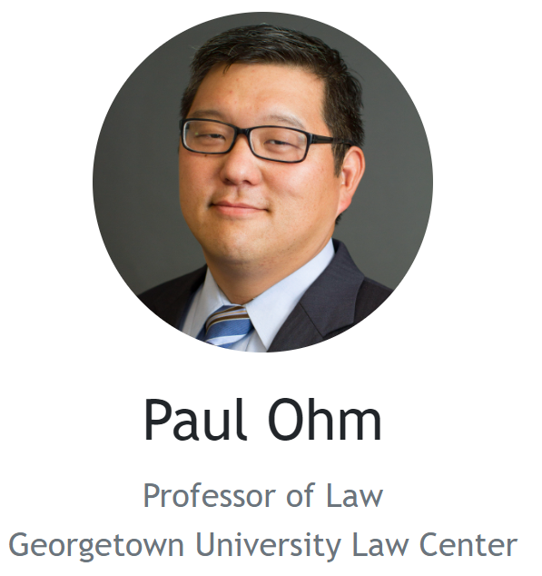
Paul Ohm, “Broken Promises of Privacy: Responding to the Surprising Failure of Anonymization”, UCLA Law Review 57 (2010).
Core Idea. Anonymity has become increasingly ineffective in protecting privacy, and legislation recognizing anonymity is a major mistake that should be corrected.
technologists have believed that they could robustly protect people’s privacy by making small changes to their data, using techniques - the robust anonymization assumption.
Privacy laws and regulations use anonymization technology to desensitize private data to ensure the free flow of data and balance the interests of privacy security and information flow.
The easy reidentification result, which proves that the robust anonymization assumption is deeply flawed. By undermining the robust anonymization assumption, easy reidentification will topple the edifices of promise and expectation we have built upon anonymization.
The easy reidentification result will also wreak havoc on our legal systems because our faith in robust anonymization has thoroughly infiltrated our privacy laws and regulations, as Part II explores.

Slide 43
Paul Ohm, “Broken Promises of Privacy: Responding to the Surprising Failure of Anonymization”, UCLA Law Review 57 (2010).
核心理念： 匿名在保护隐私方面已变得越来越无效，承认匿名性的立法是一个应被纠正的重大错误。
技术专家们曾相信，他们可以通过对数据进行微小改动来可靠地保护人们的隐私，这种技术被称为“强匿名化假设”（the robust anonymization assumption）。
隐私法律法规利用匿名化技术对私密数据进行脱敏，以确保数据的自由流动，并在隐私安全与信息流动之间取得利益平衡。
“轻易再识别”（easy reidentification）的结果证明了“强匿名化假设”存在严重缺陷。通过颠覆这一假设，“轻易再识别”将推翻我们建立在匿名化之上的承诺与期望的殿堂。
“轻易再识别”的结果也将对我们的法律体系造成严重破坏，因为正如第二部分将探讨的那样，我们对“强匿名化”的信念已经彻底渗透到了我们的隐私法律法规之中。

Slide 44
Paul Ohm, “Broken Promises of Privacy: Responding to the Surprising Failure of Anonymization”, UCLA Law Review 57 (2010).
Anonymization technology has long lost its effectiveness under the impact of anti-anonymization technology, and both of them hinder the protection of personal privacy by privacy law, which breaks the balance between privacy law protection and information flow.
Three common approaches that might be used to address these imbalances.
1. Punish violations of privacy and provide compensation.
Even if such a solution involves an aggressive expansion of harm compensation—with new laws defining new types of harms and increasing resources for enforcement—this is a half measure, a necessary but not sufficient solution.
2. Circumvent problems with new technology that offers the best of both worlds.
Unfortunately, although technologists will develop better privacy-protection techniques, they will run up against important theoretical limits. Nothing they devise will share the single-bullet universal power once promised by anonymization, and thus any technical solutions they offer must be backed by regulatory approaches.
3. Anti-anonymization techniques are prohibited.

Slide 45
Paul Ohm, “Broken Promises of Privacy: Responding to the Surprising Failure of Anonymization”, UCLA Law Review 57 (2010).
在反匿名化技术的冲击下，匿名化技术早已失效，而这两者都阻碍了隐私法对个人隐私的保护，打破了隐私法保护与信息流动之间的平衡。
（以下是）可能用于解决这些失衡问题的三种常见方法：
惩罚侵犯隐私的行为并提供赔偿。
即便这种解决方案包含了对损害赔偿的积极扩展——通过新法律定义新型损害并增加执法资源——这也只是一种折中措施，是一个必要但不充分的解决方案。
用新技术规避问题，以期两全其美。
不幸的是，尽管技术专家会开发出更好的隐私保护技术，但他们将遇到重要的理论限制。他们设计的任何技术都不会拥有像匿名化曾经承诺的那样“一招致胜”的普适力量，因此他们提供的任何技术解决方案都必须得到监管方法的支持。
禁止反匿名化技术。

